Slide 1
Machine Instructions and Programs

Slide 2
Objectives
Machine instructions and program execution, including branching and subroutine call and return operations.
Number representation and addition/subtraction in the 2’s-complement system.
Addressing methods for accessing register and memory operands.
Assembly language for representing machine instructions, data, and programs.
Program-controlled Input/Output operations.

Slide 3
Number, Arithmetic Operations, and Characters

Slide 4
Signed Integer
3 major representations:
Sign and magnitude
One’s complement
Two’s complement
Assumptions:
4-bit machine word
16 different values can be represented
Roughly half are positive, half are negative

Slide 5
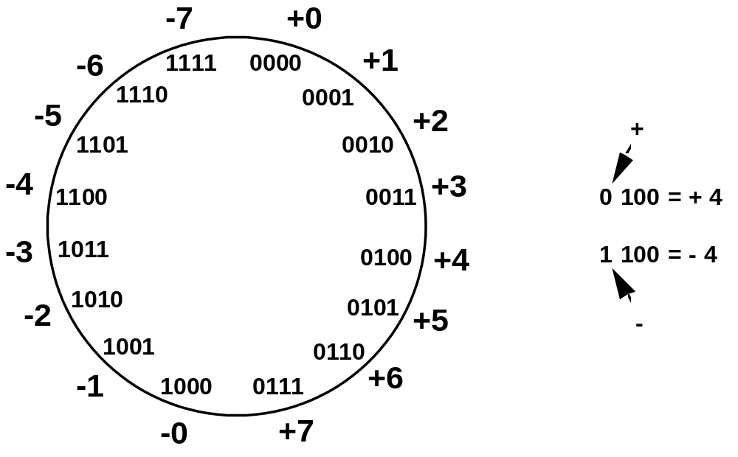
Sign and Magnitude Representation
High order bit is sign: 0 = positive (or zero), 1 = negative
Three low order bits is the magnitude: 0 (000) thru 7 (111)
Number range for n bits = +/-2^{n-1} -1
Two representations for 0

Slide 6
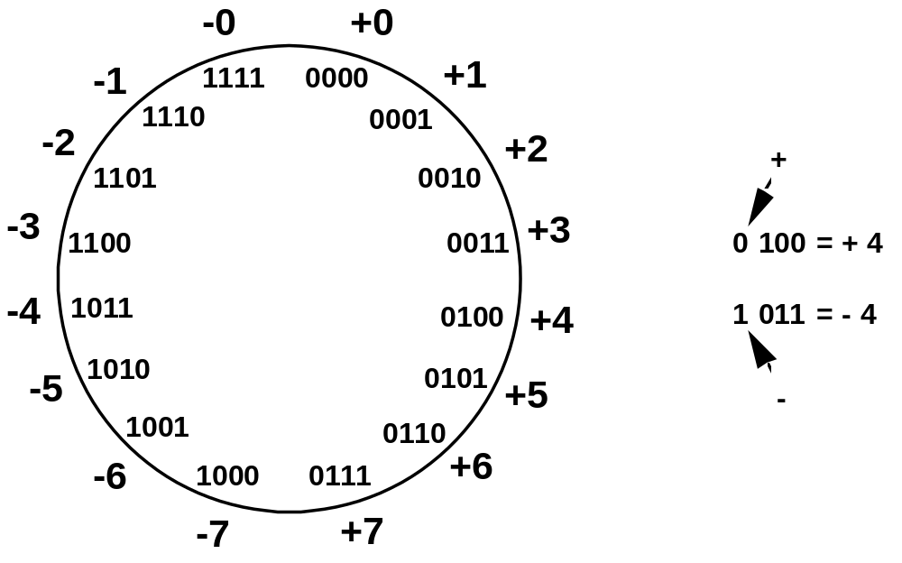
One’s Complement Representation
Subtraction implemented by addition & 1's complement
Still two representations of 0! This causes some problems
Some complexities in addition

Slide 7
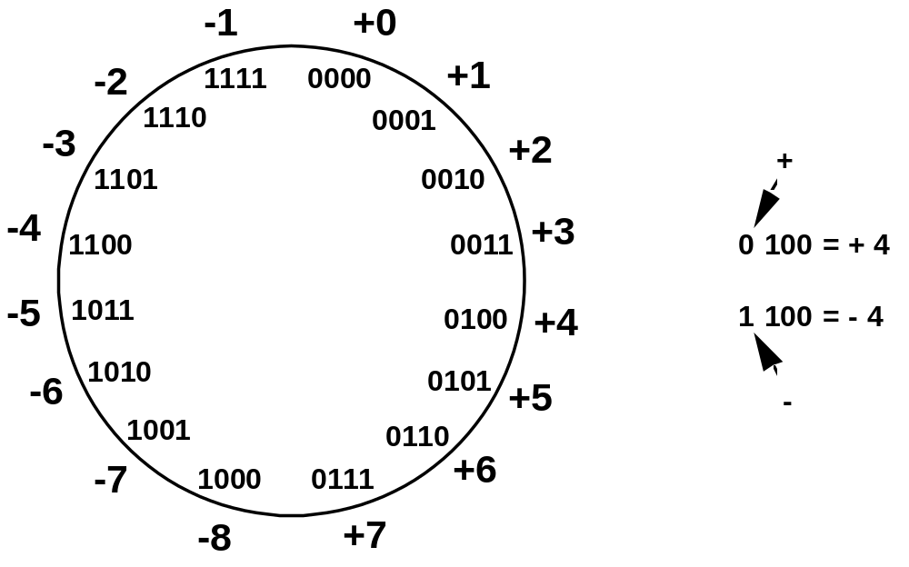
Two’s Complement Representation
like 1's comp
except shifted
one position
clockwise
Only one representation for 0
One more negative number than positive number

Slide 8
Binary, Signed-Integer Representations
Page 28
B
V
alues represented
Sign and
b
3
b
2
b
1
b
0
magnitude
1'
s complement
2'
s complement
0
1
1
1
+
7
+
7
+
7
0
1
1
0
+
6
+
6
+
6
0
1
0
1
+
5
+
5
+
5
0
1
0
0
+
4
+
4
+
4
0
0
1
1
+
3
+
3
+
3
0
0
1
0
+
2
+
2
+
2
0
0
0
1
+
1
+
1
+
1
0
0
0
0
+
0
+
0
+
0
1
0
0
0
-
0
-
7
-
8
1
0
0
1
-
1
-
6
-
7
1
0
1
0
-
2
-
5
-
6
1
0
1
1
-
3
-
4
-
5
1
1
0
0
-
4
-
3
-
4
1
1
0
1
-
5
-
2
-
3
1
1
1
0
-
6
-
1
-
2
1
1
1
1
-
7
-
0
-
1
Figure 2.1. Binary, signed-integer representations.

Slide 9
Addition and Subtraction – 2’s Complement
4
+ 3
7
0100
0011
0111
-4
+ (-3)
-7
1100
1101
11001
If carry-in to the high
order bit =
carry-out then ignore
carry
if carry-in differs from
carry-out then overflow
4
- 3
1
0100
1101
10001
-4
+ 3
-1
1100
0011
1111
Simpler addition scheme makes twos complement the most common
choice for integer number systems within digital systems

Slide 10
2’s-Complement Add and Subtract Operations
(a)
0 0 1 0
(
+
2
)
(b)
0 1 0 0
(
+
4
)
Page 31
+
0 0 1 1
(
+
3
)
+
1 0 1 0
(
-
6
)
0 1 0 1
(
+
5
)
1 1 1 0
(
-
2
)
(c)
1 0 1 1
(
-
5
)
(d)
0 1 1 1
(
+
7
)
+
1 1 1 0
(
-
2
)
+
1 1 0 1
(
-
3
)
1 0 0 1
(
-
7
)
0 1 0 0
(
+
4
)
(e)
1 1 0 1
(
-
3
)
1 1 0 1
-
1 0 0 1
(
-
7
)
+
0 1 1 1
0 1 0 0
(
+
4
)
(f)
0 0 1 0
(
+
2
)
0 0 1 0
-
0 1 0 0
(
+
4
)
+
1 1 0 0
1 1 1 0
(
-
2
)
(g)
0 1 1 0
(
+
6
)
0 1 1 0
-
0 0 1 1
(
+
3
)
+
1 1 0 1
0 0 1 1
(
+
3
)
(h)
1 0 0 1
(
-
7
)
1 0 0 1
-
1 0 1 1
(
-
5
)
+
0 1 0 1
1 1 1 0
(
-
2
)
(i)
1 0 0 1
(
-
7
)
1 0 0 1
-
0 0 0 1
(
+
1
)
+
1 1 1 1
1 0 0 0
(
-
8
)
(j)
0 0 1 0
(
+
2
)
0 0 1 0
-
1 1 0 1
(
-
3
)
+
0 0 1 1
0 1 0 1
(
+
5
)
Figure 2.4. 2's-complement Add and Subtract operations.

Slide 11
Overflow - Add two positive numbers to get a negative number or two negative numbers to get a positive number
-1
+0
-1
+0
-2
1111
0000
+1
-2
1111
0000
+1
-3
1110
0001
-3
1110
0001
1101
+2
1101
+2
-4
0010
-4
0010
1100
0011
+3
1100
0011
+3
-5
1011
-5
0100
+4
1011
0100
+4
-6
1010
-6
1010
0101
+5
0101
+5
1001
0110
1001
0110
-7
1000
+6
-7
+6
0111
1000
0111
-8
+7
-8
+7
5 + 3 = -8
-7 - 2 = +7

Slide 12
Overflow Conditions
0 1 1 1
0 1 0 1
0 0 1 1
1 0 0 0
1 0 0 0
1 0 0 1
1 1 0 0
1 0 1 1 1
5
3
-8
-7
-2
7
Overflow
Overflow
0 0 0 0
0 1 0 1
0 0 1 0
0 1 1 1
1 1 1 1
1 1 0 1
1 0 1 1
1 1 0 0 0
5
2
7
-3
-5
-8
No overflow
No overflow
Overflow when carry-in to the high-order bit does not equal carry out

Slide 13
Sign Extension
Task:
  Given w-bit signed integer x
  Convert it to w+k-bit integer with same value
Rule:
  Make k copies of sign bit:
  X ′ = x_{w–1} ,…, x_{w–1} , x_{w–1} , x_{w–2} ,…, x₀
w
X
• • •
k copies of MSB
• • •
X ′
• • •
• • •
k
w

Slide 14
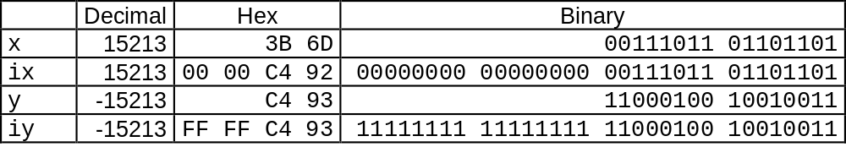
Sign Extension Example
short int x = 15213;
int ix = (int) x;
short int y = -15213;
int iy = (int) y;

Slide 15
Memory Locations, Addresses, and Operations

Slide 16
Memory Location, Addresses, and Operation
n
bits
Memory consists of many millions of storage cells, each of which can store 1 bit.
Data is usually accessed in n-bit groups. n is called word length.
first word
second word
•
•
•
i
th word
•
•
•
last word
Figure 2.5. Memory words.

Slide 17
Memory Location, Addresses, and Operation
32-bit word length example
32 bits
•
•
•
b
31
b
30
b
1
b
0
Sign bit:
b
31
=
0
for positive numbers
b
31
=
1
for negative numbers
(a) A signed integer
8 bits
8 bits
8 bits
8 bits
ASCII
ASCII
ASCII
ASCII
character
character
character
character
(b) Four characters

Slide 18
Memory Location, Addresses, and Operation
To retrieve information from memory, either for one word or one byte (8-bit), addresses for each location are needed.
A k-bit address memory has 2^{k} memory locations, namely 0 – 2^{k}-1, called memory space.
24-bit memory: 2²⁴ = 16,777,216 = 16M (1M=2²⁰)
32-bit memory: 2³² = 4G (1G=2³⁰)
1K(kilo)=2¹⁰
1T(tera)=2⁴⁰

Slide 19
Memory Location, Addresses, and Operation
It is impractical to assign distinct addresses to individual bit locations in the memory.
The most practical assignment is to have successive addresses refer to successive byte locations in the memory – byte-addressable memory.
Byte locations have addresses 0, 1, 2, … If word length is 32 bits, they successive words are located at addresses 0, 4, 8,…

Slide 20
Big-Endian and Little-Endian Assignments
Big-Endian: lower byte addresses are used for the most significant bytes of the word
Little-Endian: opposite ordering. lower byte addresses are used for the less significant bytes of the word
W
ord
address
Byte address
Byte address
0
0
1
2
3
0
3
2
1
0
4
4
5
6
7
4
7
6
5
4
•
•
•
•
•
•
2
k
-
4
2
k
-
4
2
k
-
3
2
k
-
2
2
k
-
1
2
k
-
4
2
k
-
1
2
k
-
2
2
k
-
3
2
k
-
4
(a) Big-endian assignment
(b) Little-endian assignment
Figure 2.7. Byte and word addressing.

Slide 21
Memory Location, Addresses, and Operation
Address ordering of bytes
Word alignment
  Words are said to be aligned in memory if they begin at a byte addr. that is a multiple of the num of bytes in a word.
    16-bit word: word addresses: 0, 2, 4,….
    32-bit word: word addresses: 0, 4, 8,….
    64-bit word: word addresses: 0, 8,16,….
Access numbers, characters, and character strings

Slide 22
Memory Operation
Load (or Read or Fetch)
Copy the content. The memory content doesn’t change.
Address – Load
Registers can be used
Store (or Write)
Overwrite the content in memory
Address and Data – Store
Registers can be used

Slide 23
Instruction and Instruction Sequencing

Slide 24
“Must-Perform” Operations
Data transfers between the memory and the processor registers
Arithmetic and logic operations on data
Program sequencing and control
I/O transfers

Slide 25
Register Transfer Notation
Identify a location by a symbolic name standing for its hardware binary address (LOC, R0,…)
Contents of a location are denoted by placing square brackets around the name of the location (R1←[LOC], R3 ←[R1]+[R2])
Register Transfer Notation (RTN)

Slide 26
Assembly Language Notation
Represent machine instructions and programs.
Move LOC, R1 = R1←[LOC]
Add R1, R2, R3 = R3 ←[R1]+[R2]

Slide 27
CPU Organization
Single Accumulator
  Result usually goes to the Accumulator
  Accumulator has to be saved to memory quite often
General Register
  Registers hold operands thus reduce memory traffic
  Register bookkeeping
Stack
  Operands and result are always in the stack

Slide 28
Instruction Formats
Three-Address Instructions
  ADD R1, R2, R3 R1 ← R2 + R3
Two-Address Instructions
  ADD R1, R2 R1 ← R1 + R2
One-Address Instructions
  ADD M AC ← AC + M[AR]
Zero-Address Instructions
  ADD TOS ← TOS + (TOS – 1)
RISC Instructions
  Lots of registers. Memory is restricted to Load & Store
Instruction
Opcode
Operand(s) or Address(es)

Slide 29
Instruction Formats
Example: Evaluate (A+B) ∗ (C+D)
Three-Address
  ADD R1, A, B ; R1 ← M[A] + M[B]
  ADD R2, C, D ; R2 ← M[C] + M[D]
  MUL X, R1, R2 ; M[X] ← R1 ∗ R2

Slide 30
Instruction Formats
Example: Evaluate (A+B) ∗ (C+D)
Two-Address
  MOV R1, A ; R1 ← M[A]
  ADD R1, B ; R1 ← R1 + M[B]
  MOV R2, C ; R2 ← M[C]
  ADD R2, D ; R2 ← R2 + M[D]
  MUL R1, R2 ; R1 ← R1 ∗ R2
  MOV X, R1 ; M[X] ← R1

Slide 31
Instruction Formats
Example: Evaluate (A+B) ∗ (C+D)
One-Address
  LOAD A ; AC ← M[A]
  ADD B ; AC ← AC + M[B]
  STORE T ; M[T] ← AC
  LOAD C ; AC ← M[C]
  ADD D ; AC ← AC + M[D]
  MUL T ; AC ← AC ∗ M[T]
  STORE X ; M[X] ← AC

Slide 32
Instruction Formats
Example: Evaluate (A+B) ∗ (C+D)
Zero-Address
  PUSH A ; TOS ← A
  PUSH B ; TOS ← B
  ADD ; TOS ← (A + B)
  PUSH C ; TOS ← C
  PUSH D ; TOS ← D
  ADD ; TOS ← (C + D)
  MUL ; TOS ← (C+D)∗(A+B)
  POP X ; M[X] ← TOS

Slide 33
Instruction Formats
Example: Evaluate (A+B) ∗ (C+D)
RISC
  LOAD R1, A ; R1 ← M[A]
  LOAD R2, B ; R2 ← M[B]
  LOAD R3, C ; R3 ← M[C]
  LOAD R4, D ; R4 ← M[D]
  ADD R1, R1, R2 ; R1 ← R1 + R2
  ADD R3, R3, R4 ; R3 ← R3 + R4
  MUL R1, R1, R3 ; R1 ← R1 ∗ R3
  STORE X, R1 ; M[X] ← R1

Slide 34
Using Registers
Registers are faster
Shorter instructions
  The number of registers is smaller (e.g. 32 registers need 5 bits)
Potential speedup
Minimize the frequency with which data is moved back and forth between the memory and processor registers.

Slide 35
Instruction Execution and Straight-Line Sequencing
Address
Contents
Assumptions:
- One memory operand
per instruction
- 32-bit word length
- Memory is byte
addressable
- Full memory address
can be directly specified
in a single-word instruction
Begin execution here
i
Move
A,R0
3-instruction
i
+ 4
Add
B,R0
program
segment
i
+ 8
Move
R0,C
A
B
Data for
the program
Two-phase procedure
Instruction fetch
Instruction execute
C
Page 43
Figure 2.8. A program for C ← [Α] + [Β].

Slide 36
Branching
i
Move
NUM1,R0
i
+
4
Add
NUM2,R0
i
+
8
Add
NUM3,R0
•
•
•
i
+
4
n
-
4
Add
NUM
n
,R0
i
+
4
n
Move
R0,SUM
•
•
•
SUM
NUM1
NUM2
•
•
•
NUM
n
Figure 2.9. A straight-line program for adding n numbers.

Slide 37
Branching
Move
N,R1
Clear
R0
LOOP
Determine address of
"Next" number and add
Program
"Next" number to R0
loop
Decrement
R1
Branch target
Branch>0
LOOP
Move
R0,SUM
Conditional branch
•
•
•
SUM
N
n
NUM1
Figure 2.10. Using a loop to add n numbers.
NUM2
•
•
•
NUM
n

Slide 38
Condition Codes
Condition code flags
Condition code register / status register
N (negative)
Z (zero)
V (overflow)
C (carry)
Different instructions affect different flags

Slide 39
Conditional Branch Instructions
A: 1 1 1 1 0 0 0 0
Example:
  A: 1 1 1 1 0 0 0 0
  B: 0 0 0 1 0 1 0 0
+(−B): 1 1 1 0 1 1 0 0
1 1 0 1 1 1 0 0
C = 1
Z = 0
S = 1
V = 0

Slide 40

Status Bits
C_{n-1}
A
B
C_{n}
ALU
F
V
Z
S
C
F_{n-1}
Zero Check

Slide 41
Addressing Modes

Slide 42
Generating Memory Addresses
How to specify the address of branch target?
Can we give the memory operand address directly in a single Add instruction in the loop?
Use a register to hold the address of NUM1; then increment by 4 on each pass through the loop.

Slide 43
Addressing Modes
Implied
  AC is implied in “ADD M[AR]” in “One-Address” instr.
  TOS is implied in “ADD” in “Zero-Address” instr.
Immediate
  The use of a constant in “MOV R1, 5”, i.e. R1 ← 5
Register
  Indicate which register holds the operand
Instruction
Opcode
Mode
...

Slide 44
Addressing Modes
Register Indirect
  Indicate the register that holds the number of the register that holds the operand
    MOV R1, (R2)
Autoincrement / Autodecrement
  Access & update in 1 instr.
Direct Address
  Use the given address to access a memory location
R1
R2 = 3
R3 = 5

Slide 45
Addressing Modes
Indirect Address
  Indicate the memory location that holds the address of the memory location that holds the data
Memory
AR = 101
100
101
0 1 0 4
102
103
104
1 1 0 A

Slide 46
Addressing Modes
Memory
Relative Address
  EA = PC + Relative Addr
0
1
Program
PC = 2
2
+
100
Data
AR = 100
101
102
1 1 0 A
Could be Positive or Negative
(2’s Complement)
103
104

Slide 47
Addressing Modes
Indexed
  EA = Index Register + Relative Addr
Memory
Useful with “Autoincrement” or “Autodecrement”
XR = 2
+
100
AR = 100
101
Could be Positive or Negative
(2’s Complement)
102
1 1 0 A
103
104

Slide 48
Addressing Modes
Base Register
  EA = Base Register + Relative Addr
Memory
Could be Positive or Negative
(2’s Complement)
AR = 2
+
100
0 0 0 5
BR = 100
101
0 0 1 2
102
0 0 0 A
Usually points to the beginning of an array
103
0 1 0 7
104
0 0 5 9

Slide 49
Addressing Modes
Name
Assem
bler
syn
tax
Addressing
function
The different ways in which the location of an operand is specified in an instruction are referred to as addressing modes.
Immediate
#V
alue
Op
erand
=
V
alue
Register
R
i
EA
=
R
i
Absolute
(Direct)
LOC
EA
=
LOC
Indirect
(R
i
)
EA
=
[R
i
]
(LOC)
EA
=
[LOC]
Index
X(R
i
)
EA
=
[R
i
]
+
X
Base
with
index
(R
i
,R
j
)
EA
=
[R
i
]
+
[R
j
]
Base
with
index
X(R
i
,R
j
)
EA
=
[R
i
]
+
[R
j
]
+
X
and
offset
Relative
X(PC)
EA
=
[PC]
+
X
Autoincremen
t
(R
i
)+
EA
=
[R
i
]
;
Incremen
t
R
i
Autodecrement
−
(R
i
)
Decremen
t
R
i
;
EA
=
[R
i
]

Slide 50
Indexing and Arrays
Index mode – the effective address of the operand is generated by adding a constant value to the contents of a register.
Index register
X(R_{i}): EA = X + [R_{i}]
The constant X may be given either as an explicit number or as a symbolic name representing a numerical value.
If X is shorter than a word, sign-extension is needed.

Slide 51
Indexing and Arrays
In general, the Index mode facilitates access to an operand whose location is defined relative to a reference point within the data structure in which the operand appears.
Several variations:
(R_{i}, R_{j}): EA = [R_{i}] + [R_{j}]
X(R_{i}, R_{j}): EA = X + [R_{i}] + [R_{j}]

Slide 52
Relative Addressing
Relative mode – the effective address is determined by the Index mode using the program counter in place of the general-purpose register.
X(PC) – note that X is a signed number
Branch>0 LOOP
This location is computed by specifying it as an offset from the current value of PC.
Branch target may be either before or after the branch instruction, the offset is given as a singed num.

Slide 53
Additional Modes
Autoincrement mode – the effective address of the operand is the contents of a register specified in the instruction. After accessing the operand, the contents of this register are automatically incremented to point to the next item in a list.
(R_{i})+. The increment is 1 for byte-sized operands, 2 for 16-bit operands, and 4 for 32-bit operands.
Autodecrement mode: -(R_{i}) – decrement first
Move
N,R1
Move
#NUM1,R2
Initialization
Clear
R0
LOOP
Add
(R2)+,R0
Decrement
R1
Branch>0
LOOP
Move
R0,SUM
Figure 2.16. The Autoincrement addressing mode used in the program of Figure 2.12.

Slide 54
Assembly Language

Slide 55
Types of Instructions
Data Transfer Instructions
Name | Mnemonic
Load | LD
Store | ST
Move | MOV
Exchange | XCH
Input | IN
Output | OUT
Push | PUSH
Pop | POP
Data value is not modified

Slide 56
Data Transfer Instructions
Mode | Assembly | Register Transfer
Direct address | LD ADR | AC ← M[ADR]
Indirect address | LD @ADR | AC ← M[M[ADR]]
Relative address | LD $ADR | AC ← M[PC+ADR]
Immediate operand | LD #NBR | AC ← NBR
Index addressing | LD ADR(X) | AC ← M[ADR+XR]
Register | LD R1 | AC ← R1
Register indirect | LD (R1) | AC ← M[R1]
Autoincrement | LD (R1)+ | AC ← M[R1], R1 ← R1+1

Slide 57
Data Manipulation Instructions
Arithmetic
Logical & Bit Manipulation
Shift
Name | Mnemonic
Increment | INC
Decrement | DEC
Add | ADD
Subtract | SUB
Multiply | MUL
Divide | DIV
Add with carry | ADDC
Subtract with borrow | SUBB
Negate | NEG
Name | Mnemonic
Clear | CLR
Complement | COM
AND | AND
OR | OR
Exclusive-OR | XOR
Clear carry | CLRC
Set carry | SETC
Complement carry | COMC
Enable interrupt | EI
Disable interrupt | DI
Name | Mnemonic
Logical shift right | SHR
Logical shift left | SHL
Arithmetic shift right | SHRA
Arithmetic shift left | SHLA
Rotate right | ROR
Rotate left | ROL
Rotate right through carry | RORC
Rotate left through carry | ROLC

Slide 58
Program Control Instructions
Name | Mnemonic
Branch | BR
Jump | JMP
Skip | SKP
Call | CALL
Return | RET
Compare (Subtract) | CMP
Test (AND) | TST
Subtract A – B but don’t store the result
1
0
1
1
0
0
0
1
0
0
0
0
1
0
0
0
Mask
0
0
0
0
0
0
0
0

Slide 59
Conditional Branch Instructions
Mnemonic | Branch Condition | Tested Condition
BZ | Branch if zero | Z = 1
BNZ | Branch if not zero | Z = 0
BC | Branch if carry | C = 1
BNC | Branch if no carry | C = 0
BP | Branch if plus | S = 0
BM | Branch if minus | S = 1
BV | Branch if overflow | V = 1
BNV | Branch if no overflow | V = 0

Slide 60
Basic Input/Output Operations

Slide 61
I/O
The data on which the instructions operate are not necessarily already stored in memory.
Data need to be transferred between processor and outside world (disk, keyboard, etc.)
I/O operations are essential, the way they are performed can have a significant effect on the performance of the computer.

Slide 62
Program-Controlled I/O Example
Read in character input from a keyboard and produce character output on a display screen.
Rate of data transfer (keyboard, display, processor)
Difference in speed between processor and I/O device creates the need for mechanisms to synchronize the transfer of data.
A solution: on output, the processor sends the first character and then waits for a signal from the display that the character has been received. It then sends the second character. Input is sent from the keyboard in a similar way.

Slide 63
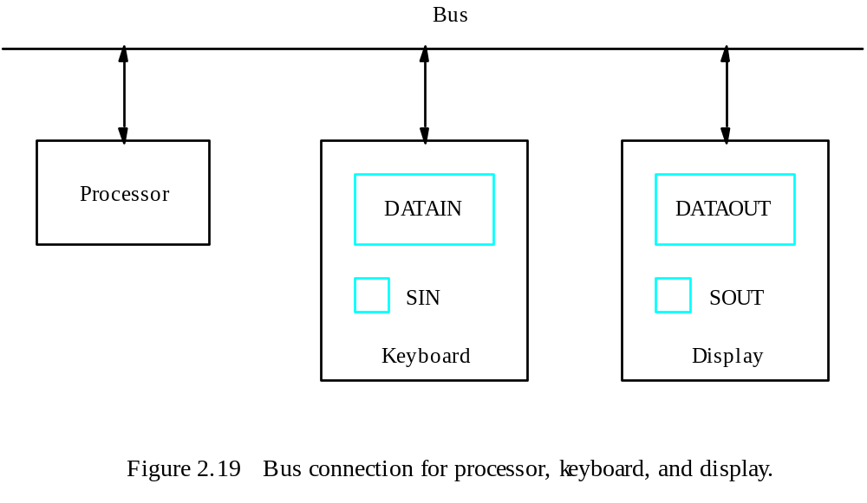
Program-Controlled I/O Example
- Registers
Flags
- Device interface

Slide 64
Program-Controlled I/O Example
Machine instructions that can check the state of the status flags and transfer data:
READWAIT Branch to READWAIT if SIN = 0
Input from DATAIN to R1
WRITEWAIT Branch to WRITEWAIT if SOUT = 0
Output from R1 to DATAOUT

Slide 65
Program-Controlled I/O Example
Memory-Mapped I/O – some memory address values are used to refer to peripheral device buffer registers. No special instructions are needed. Also use device status registers.
READWAIT Testbit #3, INSTATUS
Branch=0 READWAIT
MoveByte DATAIN, R1

Slide 66
Program-Controlled I/O Example
Assumption – the initial state of SIN is 0 and the initial state of SOUT is 1.
Any drawback of this mechanism in terms of efficiency?
  Two wait loops→processor execution time is wasted
Alternate solution?
  Interrupt

Slide 67
Stacks

Slide 68
Home Work
For each Addressing modes mentioned before, state one example for each addressing mode stating the specific benefit for using such addressing mode for such an application.

Slide 69
Stack Organization
DR
Current
Top of Stack
TOS
LIFO
  Last In First Out
0
1
2
3
4
5
SP
6
0 1 2 3
7
0 0 5 5
FULL
EMPTY
8
0 0 0 8
9
0 0 2 5
Stack Bottom
10
0 0 1 5
Stack

Slide 70
Stack Organization
DR
Current
Top of Stack
TOS
Current
Top of Stack
TOS
1 6 9 0
PUSH
  SP ← SP – 1
  M[SP] ← DR
  If (SP = 0) then (FULL ← 1)
  EMPTY ← 0
0
1
2
3
4
5
1 6 9 0
SP
6
0 1 2 3
7
0 0 5 5
FULL
EMPTY
8
0 0 0 8
9
0 0 2 5
Stack Bottom
10
0 0 1 5
Stack

Slide 71
Stack Organization
DR
Current
Top of Stack
TOS
Current
Top of Stack
TOS
POP
  DR ← M[SP]
  SP ← SP + 1
  If (SP = 11) then (EMPTY ← 1)
  FULL ← 0
0
1
2
3
4
5
1 6 9 0
1 6 9 0
SP
6
0 1 2 3
7
0 0 5 5
FULL
EMPTY
8
0 0 0 8
9
0 0 2 5
Stack Bottom
10
0 0 1 5
Stack

Slide 72
Stack Organization
Memory Stack
  PUSH
    SP ← SP – 1
    M[SP] ← DR
  POP
    DR ← M[SP]
    SP ← SP + 1
Memory
PC
0
1
Program
2
AR
100
101
Data
102
200
SP
201
Stack
202

Slide 73
Reverse Polish Notation
Infix Notation
  A + B
Prefix or Polish Notation
  + A B
Postfix or Reverse Polish Notation (RPN)
  A B +
(2) (4) ∗ (3) (3) ∗ +
(8) (3) (3) ∗ +
(8) (9) +
17
RPN
A ∗ B + C ∗ D
A B ∗ C D ∗ +

Slide 74
Reverse Polish Notation
Example
  (A + B) ∗ [C ∗ (D + E) + F]
(A B +)
(D E +)
C ∗
F +
∗

Slide 75
Reverse Polish Notation
Stack Operation
  (3) (4) ∗ (5) (6) ∗ +
PUSH 3
PUSH 4
MULT
PUSH 5
PUSH 6
MULT
ADD
6
4
5
30
3
12
42

Slide 76
Additional Instructions

Slide 77
Logical Shifts
Logical shift – shifting left (LShiftL) and shifting right (LShiftR)
C
R0
0
before:
0
0
1
1
1
0
.
.
.
0
1
1
after:
1
1
1
0
.
.
.
0
1
1
0
0
(a) Logical shift left
LShiftL #2,R0
0
R0
C
before:
0
1
1
1
0
.
.
.
0
1
1
0
after:
0
0
0
1
1
1
0
.
.
.
0
1
(b) Logical shift r
ight
LShiftR #2,R0

Slide 78
Arithmetic Shifts
R0
C
before:
1
0
0
1
1
.
.
.
0
1
0
0
after:
1
1
1
0
0
1
1
.
.
.
0
1
(c) Ar
ithmetic shift r
ight
AShiftR #2,R0

Slide 79
Rotate
C
R0
before:
0
0
1
1
1
0
.
.
.
0
1
1
after:
1
1
1
0
.
.
.
0
1
1
0
1
(a) Rotate left without carr
y
RotateL #2,R0
C
R0
before:
0
0
1
1
1
0
.
.
.
0
1
1
after:
1
1
1
0
.
.
.
0
1
1
0
0
(b) Rotate left with carr
y
RotateLC #2,R0
R0
C
before:
0
1
1
1
0
.
.
.
0
1
1
0
after:
1
1
0
1
1
1
0
.
.
.
0
1
(c) Rotate r
ight without carr
y
RotateR #2,R0
R0
C
before:
0
1
1
1
0
.
.
.
0
1
1
0
after:
1
0
0
1
1
1
0
.
.
.
0
1
(d) Rotate r
ight with carr
y
RotateRC #2,R0
Figure 2.32. Rotate instructions.

Slide 80
Multiplication and Division
Not very popular (especially division)
Multiply R_{i}, R_{j}
R_{j} ← [R_{i}] х [R_{j}]
2n-bit product case: high-order half in R(j+1)
Divide R_{i}, R_{j}
R_{j} ← [R_{i}] / [R_{j}]
  Quotient is in Rj, remainder may be placed in R(j+1)

Slide 81
Encoding of Machine Instructions

Slide 82
Encoding of Machine Instructions
Assembly language program needs to be converted into machine instructions. (ADD = 0100 in ARM instruction set)
In the previous section, an assumption was made that all instructions are one word in length.
OP code: the type of operation to be performed and the type of operands used may be specified using an encoded binary pattern
Suppose 32-bit word length, 8-bit OP code (how many instructions can we have?), 16 registers in total (how many bits?), 3-bit addressing mode indicator.
Add R1, R2
Move 24(R0), R5
LshiftR #2, R0
Move #$3A, R1
Branch>0 LOOP
8
7
7
10
OP code
Source
Dest
Other info
(a) One-word instruction

Slide 83
Encoding of Machine Instructions
What happens if we want to specify a memory operand using the Absolute addressing mode?
Move R2, LOC
14-bit for LOC – insufficient
Solution – use two words
OP code
Source
Dest
Other info
Memory address/Immediate operand
(b) Two-word instruction

Slide 84
Encoding of Machine Instructions
Then what if an instruction in which two operands can be specified using the Absolute addressing mode?
Move LOC1, LOC2
Solution – use two additional words
This approach results in instructions of variable length. Complex instructions can be implemented, closely resembling operations in high-level programming languages – Complex Instruction Set Computer (CISC)

Slide 85
Encoding of Machine Instructions
If we insist that all instructions must fit into a single 32-bit word, it is not possible to provide a 32-bit address or a 32-bit immediate operand within the instruction.
It is still possible to define a highly functional instruction set, which makes extensive use of the processor registers.
Add R1, R2 ----- yes
Add LOC, R2 ----- no
Add (R3), R2 ----- yes

